Slide 1

PROTEIN STRUCTURE CLASSIFICATION
Aparna Patil Kose
Lecturer,
Bioinformatics Dept.

Slide 2
TOOLS:
SCOP (Structural Classification of Proteins)
CATH
FSSP
HSSP
DALI

Slide 3
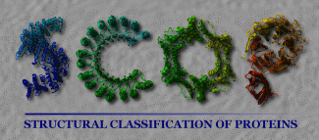

Slide 4
The recent exponential growth in the number of proteins whose structures have been determined by X-ray crystallography and NMR spectroscopy means that there is now a large and rapidly growing corpus of information available.
Nearly all proteins have structural similarities with other proteins and, in many cases, share a common evolutionary origin.
The knowledge of these relationships makes important contributions to molecular biology and to other related areas of science.

Slide 5
Homology Search
1. Enter a sequence
2. Obtain a list of any structures to which it has significant levels of sequence similarity
Proteins grouped into hierarchy of:
1. Families
2. Super families
3. Folds
4. Classes.

Slide 6
SCOP FAMILY
Proteins are clustered together into families on the basis of one of two criteria that imply their having a common evolutionary origin:
Proteins that have residue identities of 30% and greater
Proteins with lower sequence identities but whose functions and structures are very similar; for example, globins with sequence identities of 15%.

Slide 7
Families, whose proteins have low sequence identities but whose structures and, in many cases, functional features suggest that a common evolutionary origin is probable, are placed together in superfamilies.

Slide 8
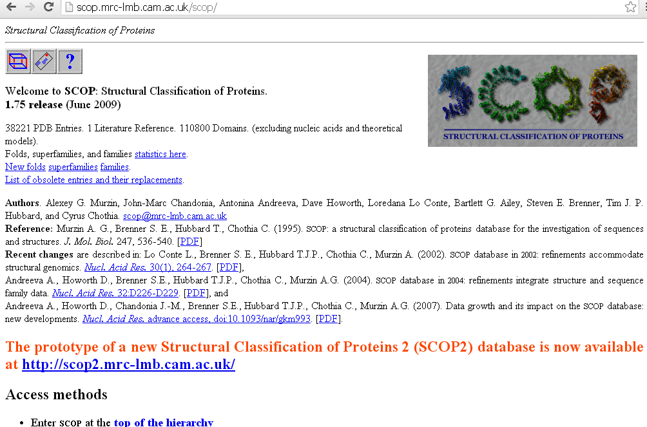

Slide 9
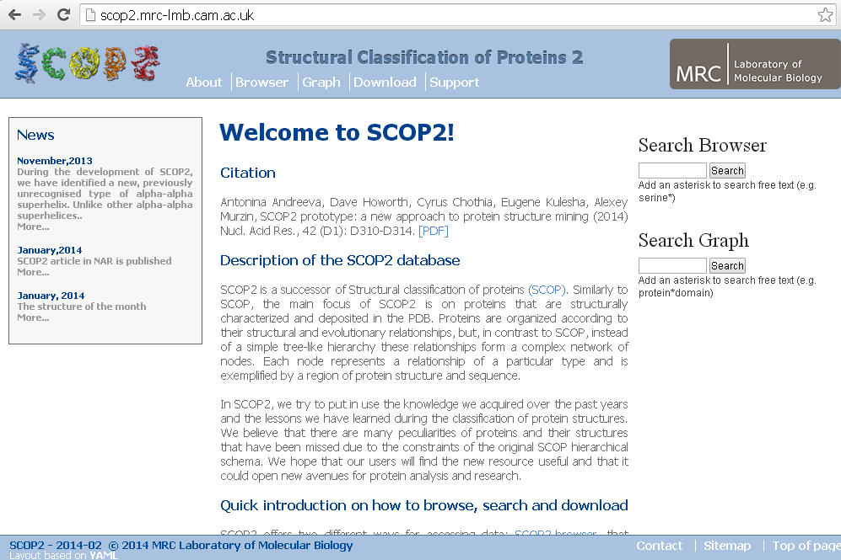

Slide 10
CATH
CATH database is classification of protein domains.
Sequences information + Structural & Functional properties.
Domains are classified in hierarchical scheme with 4 main levels a] Class (C)
b] Architecture (A) c] Topology (T)
d] Homologous Super family (H)
C-level : categories – Mainly alpha , mainly beta , mixed alpha-beta
A-level : Groups domains according to general orientation of their secondary structures.
T-level : Describes the connectivity of secondary structures.
H-level : Combination of both sequence similarity & a measure structural similarity obtained from dynamic programming algorithm.
10

Slide 11

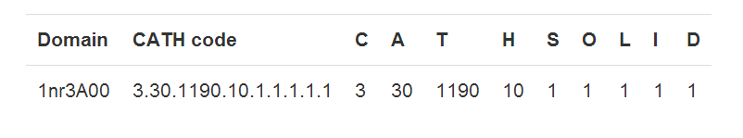
>= 35% sequence similarity.
>= 60% sequence similarity
Further Classification : Sequence Family (S35) Orthologous Family (S60) * Like domain (S95) * Identical domain (S100) Domain counter
>= 95% sequence similarity
100% sequence similarity
Unique domains
Coding System:
⚫
Domain codes (e.g. 1nr3A00) are broken up as follows: the first 4 letters/numbers make up the domains pdb code, the letter after than refers to the polypeptide chain of the domain you are looking at and the last two numbers refer to the domain number. In the case of a protein chain composing of only 1 domain, the domain number will be 00. Otherwise, the domains will be labelled, 01, 02 and so on.
11

Slide 12
Gene3D extends the CATH superfamilies to sequenced genomes and the major protein sequence repositories (i.e. UniProt) through the generation of a set of statistical models (hidden Markov models or HMMs) for each superfamily, and an in-house algorithm called DomainFinder to resolve potential matches into a unified multi-domain architecture These predicted sequence domains are presented in Gene3D.
Gene3D also merges in many different sources of protein function annotation, ranging from pathway data to active sites, and presents these through a web interface with complex querying abilities
12

Slide 13
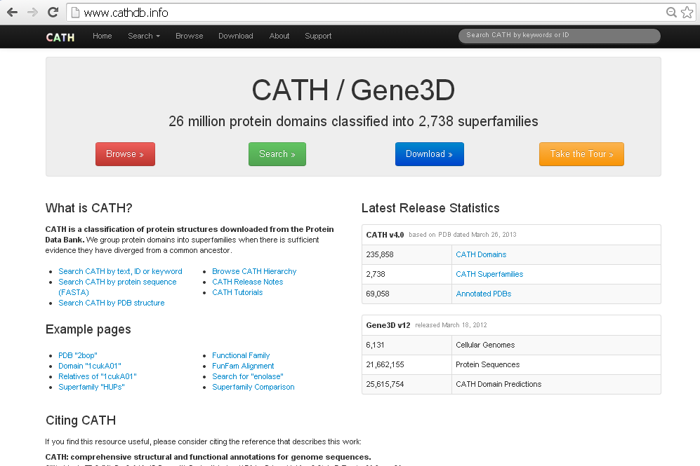

Slide 14
DISTINGUISHING FEATURES
Structured- based Classification
Built on concept of discrete families which describes intrinsic nature of fold space
Organized hierarchical Scheme ( i.e Individual layers corresponds to subset or
groups of protein domains.
Provides information about pure structure similarity , sequence similarity , protein functions , biological role and evolutionary relationship by simultaneous accessing all classification
14

Slide 15
Application :
Detect distant evolutionary relationships
Assigning structures and functions to the genome sequences (PSI-BLAST) c] Finding which folds and super families are the most populated and which
structures are rare in nature.
Finding Sequence similarity
Spatial arrangement and connectivity of secondary structures
15

Slide 16
FSSP(families of structurally similar proteins)
The FSSP database presents a continuously updated structural classification of three-dimensional protein folds.
It is derived using an automatic structure comparison program (Dali).
There is a database entry containing structure– structure alignments with its structural neighbors in the PDB.
The database is accessible online through World Wide Web browsers

Slide 17
FSSP database presents a fully automatic protein fold of known structures using the Dali method.
Each pair of structures in the PDB is related by a significance.
A view of known structures is obtained by hierarchical similarities which gives us fold classes or subclasses at
The structural alignments of a query structure with all its for detailed analyses of individual protein families.

Slide 18
HSSP (homology-derived structures of proteins)
HSSP (homology-derived structures of proteins) is a derived database merging information from 3-D structures and 1-D sequences of proteins.
For each protein of known 3-D structure from the Protein Data Bank (PDB), the database has a multiple sequence alignment of all available homologues and a sequence profile characteristic of the family.

Slide 19
HSSP
The list of homologues is the result of a database search in SwissProt using a position-weighted dynamic programming method for sequence profile alignment.
The database is updated frequently.
The database is not only a database of aligned sequence families, but also a database of implied secondary and tertiary structures covering 29% of all SwissProt-stored sequences.

Slide 20
HSSP
The file is divided into four blocks, HEADERS, PROTEINS, ALIGNMENTS and SEQUENCE PROFILE (frequency for each of the 20 amino acid residue in a given sequence position).
Limitations:
Accuracy of alignment- cannot detect gaps.

Slide 21
DALI
The Dali program is for protein structure comparison.
The web site consists of three parts:
the Dali server compares newly solved structures against structures in the Protein Data Bank (PDB),
the Dali database allows browsing precomputed structural neighbourhoods and
the pairwise comparison generates suboptimal alignments for a pair of structures. Each part has its own query form and a common format for the results page.

Slide 22
DALI
The inputs are either PDB identifiers or novel structures uploaded by the user.
The results pages are hyperlinked to aid interactive analysis.
The web interface is simple and easy to use. The key purpose of interactive analysis is to check whether conserved residues line up in multiple structural alignments and how conserved residues and ligands cluster together in multiple structure superimpositions.
In favourable cases, protein structure comparison can lead to evolutionary discoveries not detected by sequence analysis.

